Slide 1

Lesson 2
AI for Productivity
Cursor Tutorial
Cornell University
Systems Engineering
Dr. Tim Fraser
Assistant Teaching Professor

Slide 2
Summary
Date
01
02
03
04
05
06
What are LLMs?
What is Cursor?
Providing Context
Using Cursor Rules
Model Context Protocol
Activities
🤖
📝
🧮
🧩
✅

Slide 3

🤖 What are LLMs?
Date
🤖 Large Language Models are neural networks
🧠trained on massive text corpora to predict the next token
📚 LLMs learn statistical patterns in language
🔁 Output is probabilistic, not deterministic → so same input ≠ same answer
🌐Example LLM Providers
OpenAI’s GPT series
Google’s Gemini
Cursor’s Composer

Slide 4
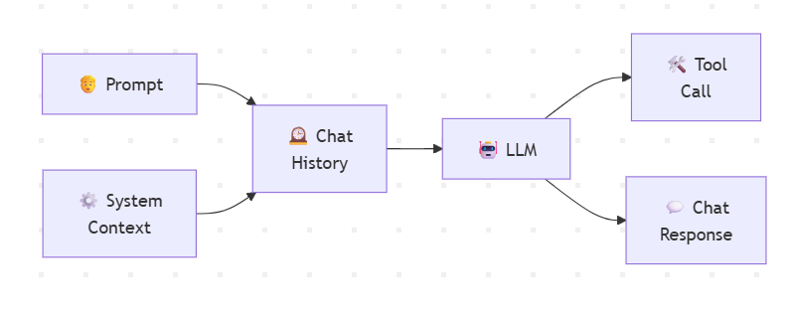
🤖 What are LLMs?
Date
⚙️ How do LLMs work?
🧩 System prompt: sets rules, behavior, and constraints (usually hidden from users)
🗣️ User prompt: what you explicitly ask for
🕰️ Chat history: prior turns that shape context and continuity
🧮 Model combines all three → predicts next tokens until a stop condition
🌐Example LLM Providers
OpenAI’s GPT series
Google’s Gemini
Cursor’s Composer
Notes:
flowchart LR
%% Core inputs
S["⚙️ System<br>Context"]
U["🧑 Prompt"]
H["🕰️ Chat<br>History"]
%% Model
LLM["🤖 LLM"]
%% LLM action types
TC["🛠️ Tool<br>Call"]
CR["💬 Chat<br>Response"]
%% Prompt assembly
U --> H
S --> H
H --> LLM
%% LLM decision
LLM --> TC
LLM --> CR

Slide 5
Discussion
How have you used LLMs in the past?
What kind?
What worked? What didn’t?

Slide 6
🧑‍💻 What is Cursor?
Date
Cursor is designed to be used for…
🌐Understanding Unfamiliar Code
🌐Rapid Prototyping
🌐Modernizing Legacy Code
🌐Debugging Code
🌐Making Tests for your Code
🌐Review Code
🌐Document Code
🧭 a VS Code–based editor with LLMs integrated into the workflow
🔍 Understands your codebase, not just isolated snippets
🧠 Context is automatic: files, symbols, imports, and dependencies
🚀 Designed to make better, immediate use of AI-generated code.
🌐Learn more about Cursor
Cursor Docs
Supported Models
Tutorials to Learn Cursor
Notes:
Image source: https://www.altexsoft.com/media/2021/03/rest_api_works.png

Slide 7
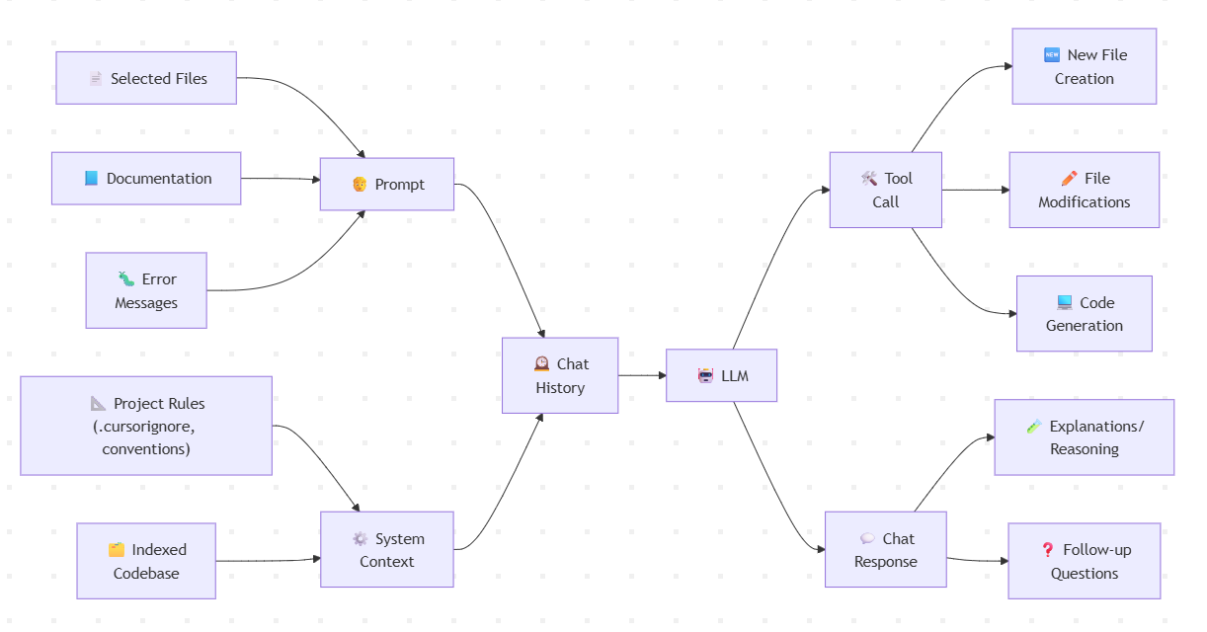
🧑‍💻 LLM Process in Cursor
Date
Notes:
flowchart LR
%% Core inputs
S["⚙️ System<br>Context"]
U["🧑 Prompt"]
H["🕰️ Chat<br>History"]
%% Inputs routed through U or S
F["📄 Selected Files"]
D["📘 Documentation"]
E["🐛 Error<br>Messages"]
R["📐 Project Rules<br>(.cursorignore, conventions)"]
I["🗂️ Indexed<br>Codebase"]
%% Model
LLM["🤖 LLM"]
%% LLM action types
TC["🛠️ Tool<br>Call"]
CR["💬 Chat<br>Response"]
%% Tool-call outputs
N["🆕 New File<br>Creation"]
M["✏️ File<br>Modifications"]
C["💻 Code<br>Generation"]
%% Direct-response outputs
X["🧪 Explanations/<br>Reasoning"]
Q["❓ Follow-up<br>Questions"]
%% Input routing
F --> U
D --> U
E --> U
R --> S
I --> S
%% Prompt assembly
U --> H
S --> H
H --> LLM
%% LLM decision
LLM --> TC
LLM --> CR
%% Output routing
TC --> N
TC --> M
TC --> C
CR --> X
CR --> Q

Slide 8
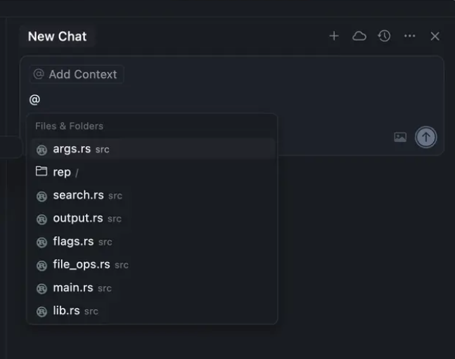
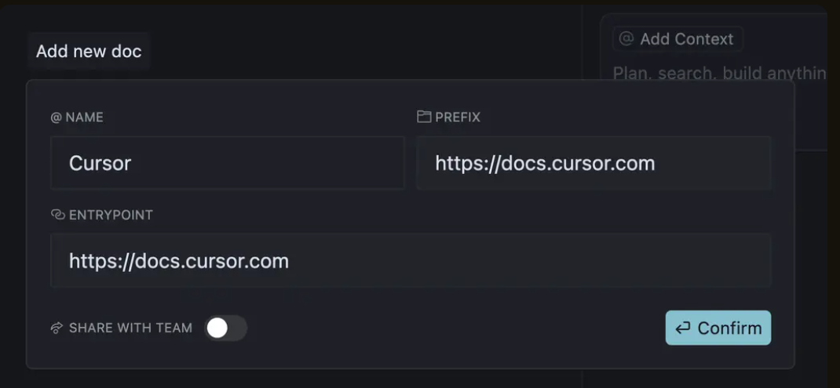
🧮 Providing Context
The whole point of Cursor is to provide your LLM with specific context to help it write/edit your codebase better. Context could include:
Files (.R, .py, .md)
Docs
Folders
Rules (later slides)
Learn more about adding context!

Slide 9
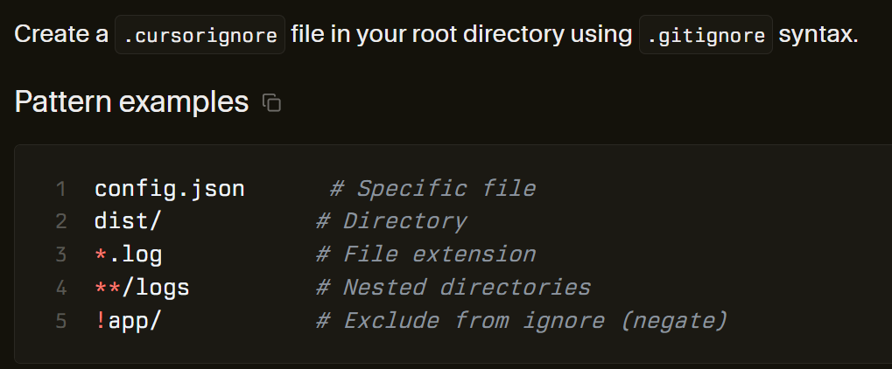
📝 Indexing your Codebase
Cursor automatically indexes your project’s codebase (all the scripts & files).
Create its own local mini-map of your repository.
However, some files get in the way, and we don’t want to index them! Eg. big.csv files, secrets, API keys, etc.
So, we add a .cursorignore file!
Learn more about Indexing and Configuring the .cursorignor file!
Learn more about Semantic Search!

Slide 10
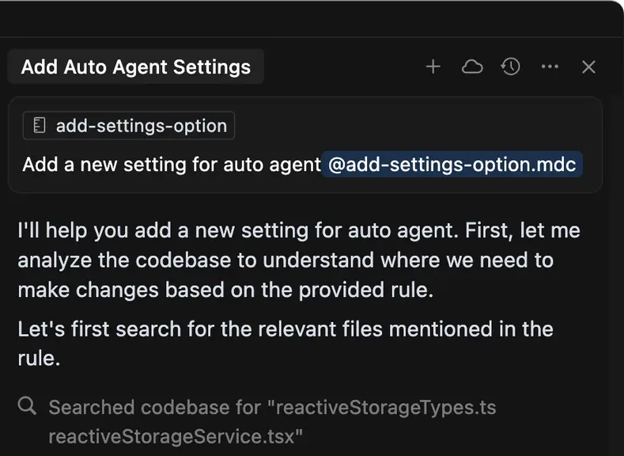
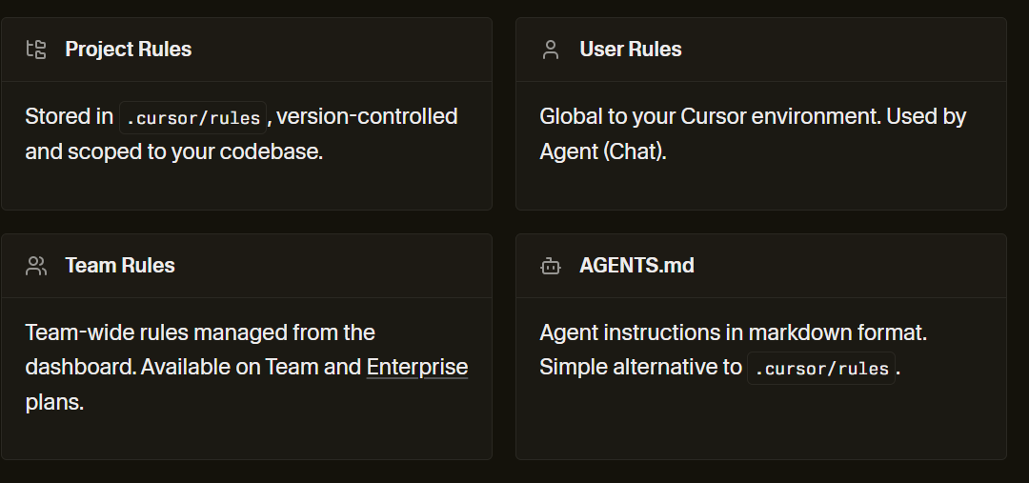
🧮 Cursor Rules
Provide standardized context to your LLM repeatedly by making rules.
Stored in a .mdc file, usually in .cursor/rules folder.
Learn more about Cursor Rules!

Slide 11
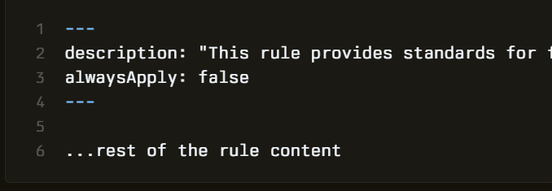
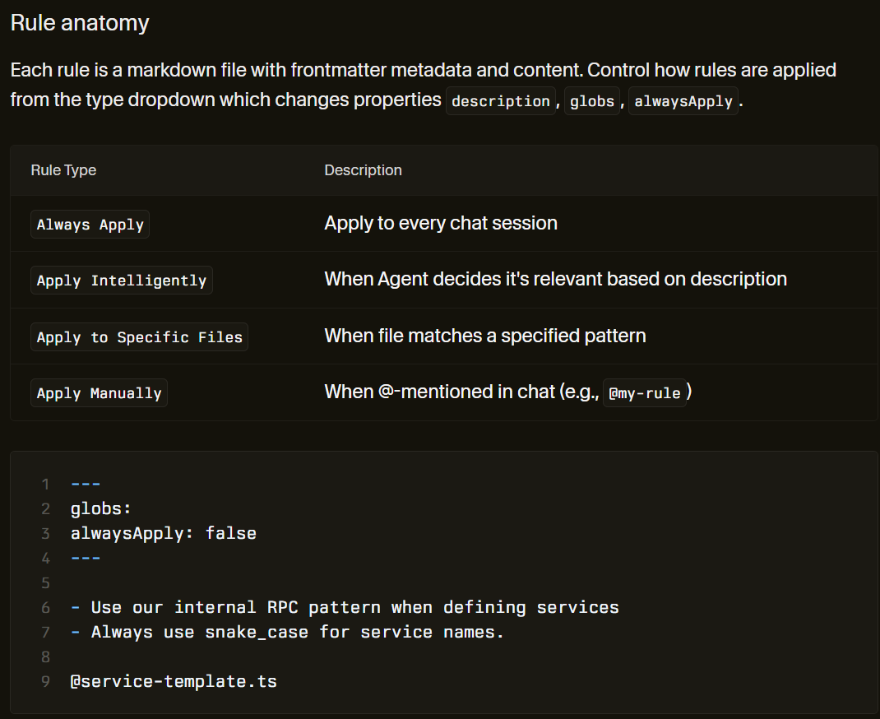
🧮 Cursor Rules (2)
Rules are special markdown files called .mdc
Contain metadata (globs, description, and alwaysApply arguments)
Tips:
Ask Cursor to design its own rules in ways/formats that would be most helpful to Cursor.
Any request you do often - turn it into a rule.
Learn more about Cursor Rules!

Slide 12
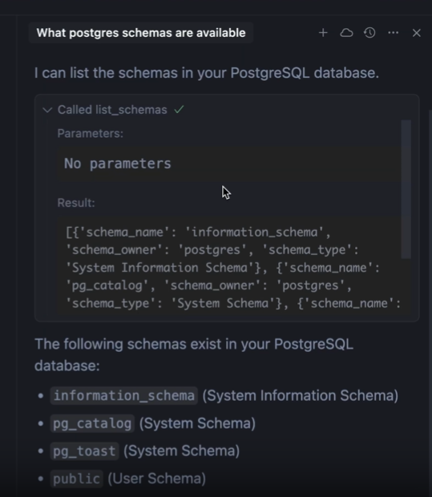
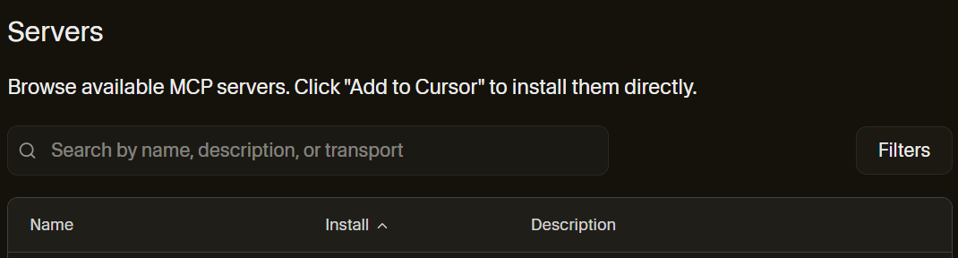
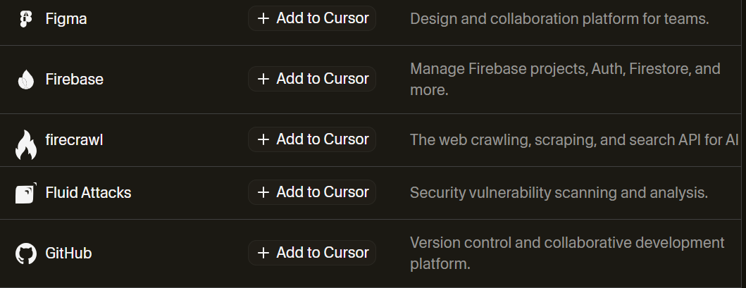
🧩Model Context Protocol (MCP)
Model Context Protocol (MCP) lets Cursor connect to external tools and data sources.
MCP servers let/teach Cursor use specific direct API calls from a company.
Eg. Zapier, Supabase, Stripe, Notion, Github, Figma, Firebase, etc.
Learn more about MCP servers!

Slide 13
ACTIVITIES

Slide 14
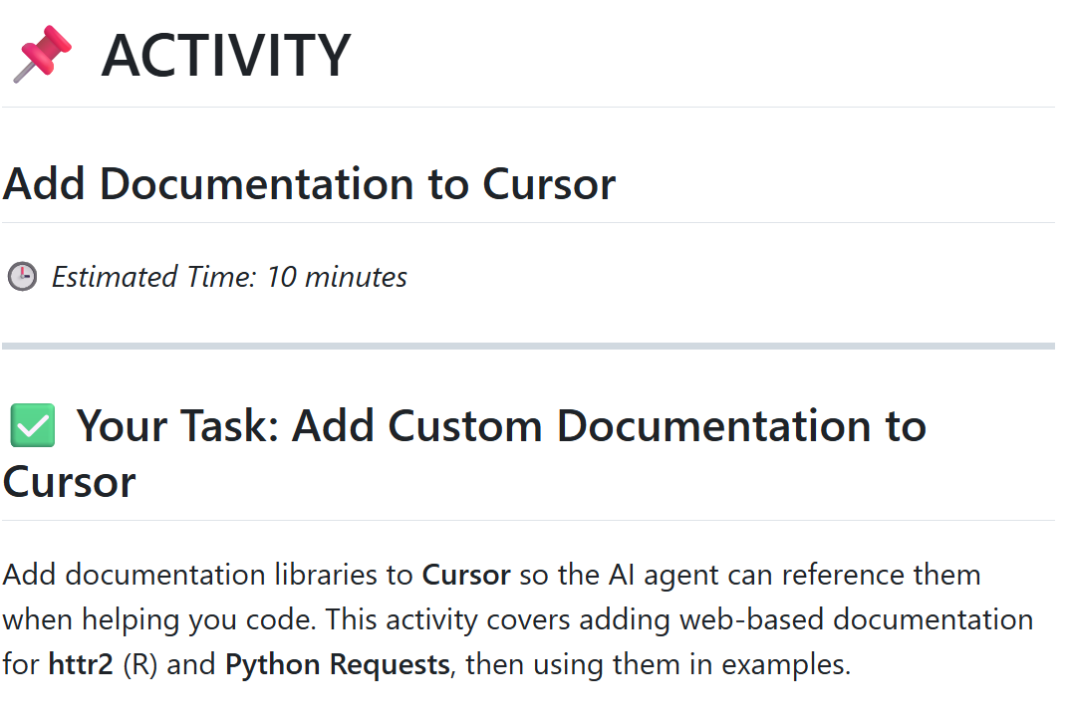
🌐ACTIVITY
https://github.com/timothyfraser/dsai/blob/main/02_productivity/ACTIVITY_add_documentation_to_cursor.md
Notes:
Image source: https://www.altexsoft.com/media/2021/03/rest_api_works.png

Slide 15
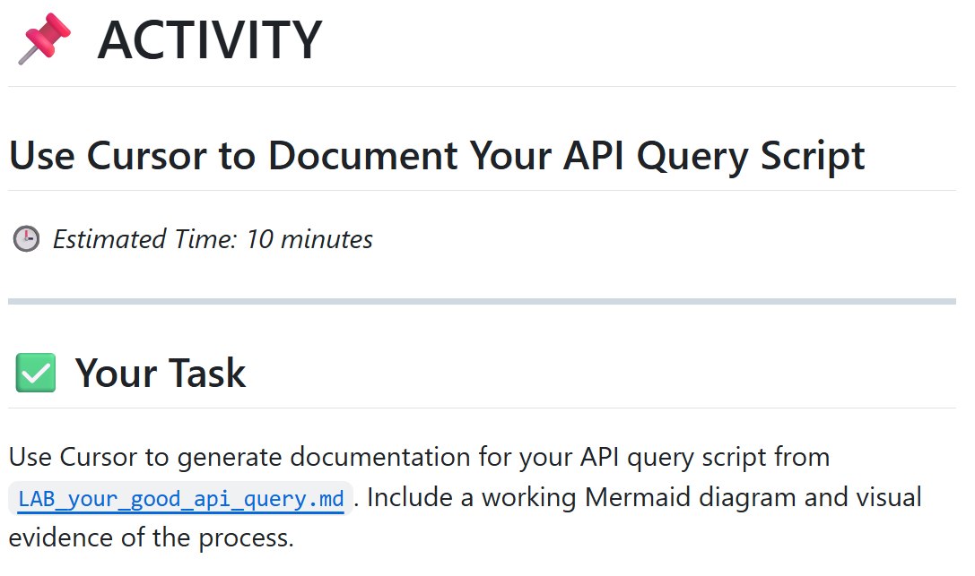
🌐ACTIVITY
https://github.com/timothyfraser/dsai/blob/main/02_productivity/ACTIVITY_cursor_documentation.md
Notes:
Image source: https://www.altexsoft.com/media/2021/03/rest_api_works.png

Slide 16
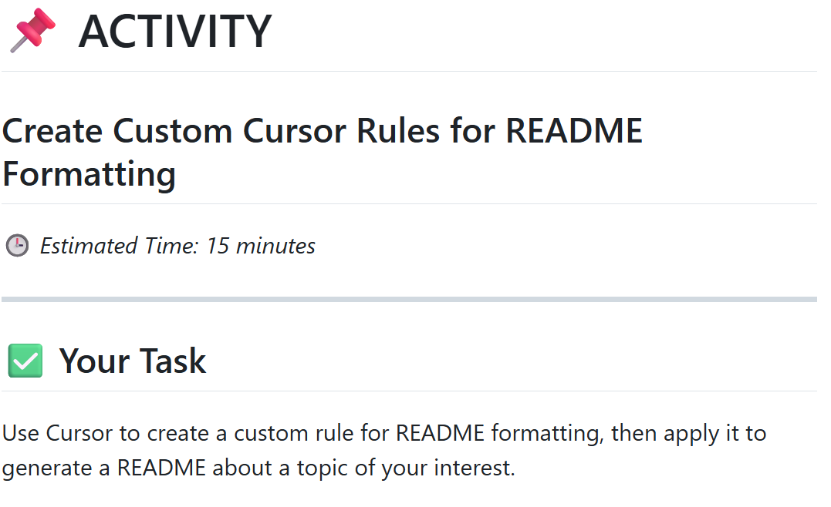
🌐ACTIVITY
https://github.com/timothyfraser/dsai/blob/main/02_productivity/ACTIVITY_cursor_rules.md
Notes:
Image source: https://www.altexsoft.com/media/2021/03/rest_api_works.png

Slide 17
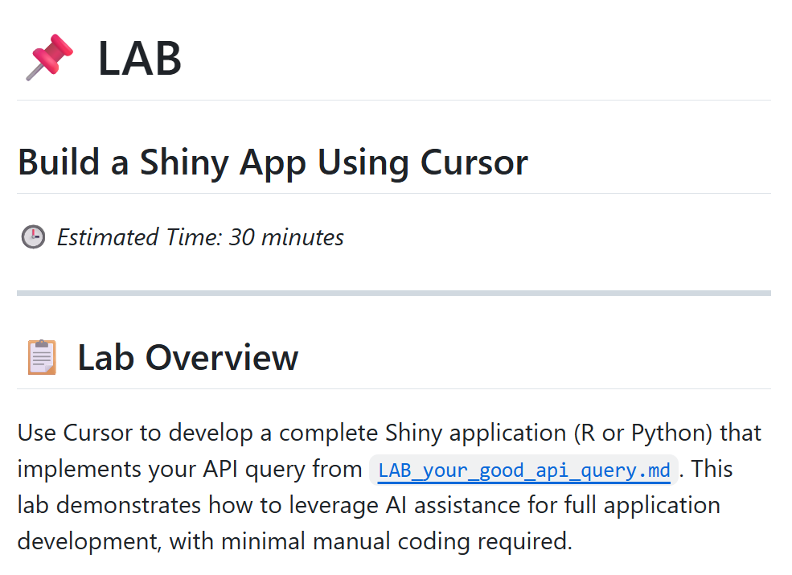
🌐LAB
https://github.com/timothyfraser/dsai/blob/main/02_productivity/LAB_cursor_shiny_app.md
Notes:
Image source: https://www.altexsoft.com/media/2021/03/rest_api_works.png

Slide 18
Happy coding!

